Slide 1
CNN vs RNN: Comparison between CNN Seq to Seq Learning and Bi-LSTM in English-Chinese Neural Machine Translation
Machine translation between Chinese and English is one of the most popular tasks in the research of Natural Language Processing. Currently, the most neural machine translation (NMT) models follow the Recurrent Neural Networks (RNN) framework and a big pain point for any RNN model training is that they are very time consuming. This project focus on comparing the performance of traditional Bidirectional RNN Models and the Convolutional Sequence to Sequence Learning (Fairseq). The result shows that the Fairseq model could yielding comparable results with much shorter training time. A model with shorter training time is pretty important as the model will be more useful in the real industry.
Hong Xu

Slide 2
Dataset and Data cleaning
I use the dataset, News Commentary V12, from WMT17.
We focus on the translation from English to Chinese. There are more than 227K parallel sentence pairs in the dataset.
3000 pairs are randomly selected as the test set and the rest are used to train the model.
Word Token: I tokenize dataset, using NLTK for English and Jieba for Chinese word segmentation.
Casing: I remove cases from English and converted all string to lower case.
Additional data cleaning
Merge blank lines: The dataset often has blank lines caused by formatting problem.
Remove non-English/Chinese sentences.
Remove HTML markup
Remove non-breaking white space. (for example: ‘\xa20’)

Slide 3
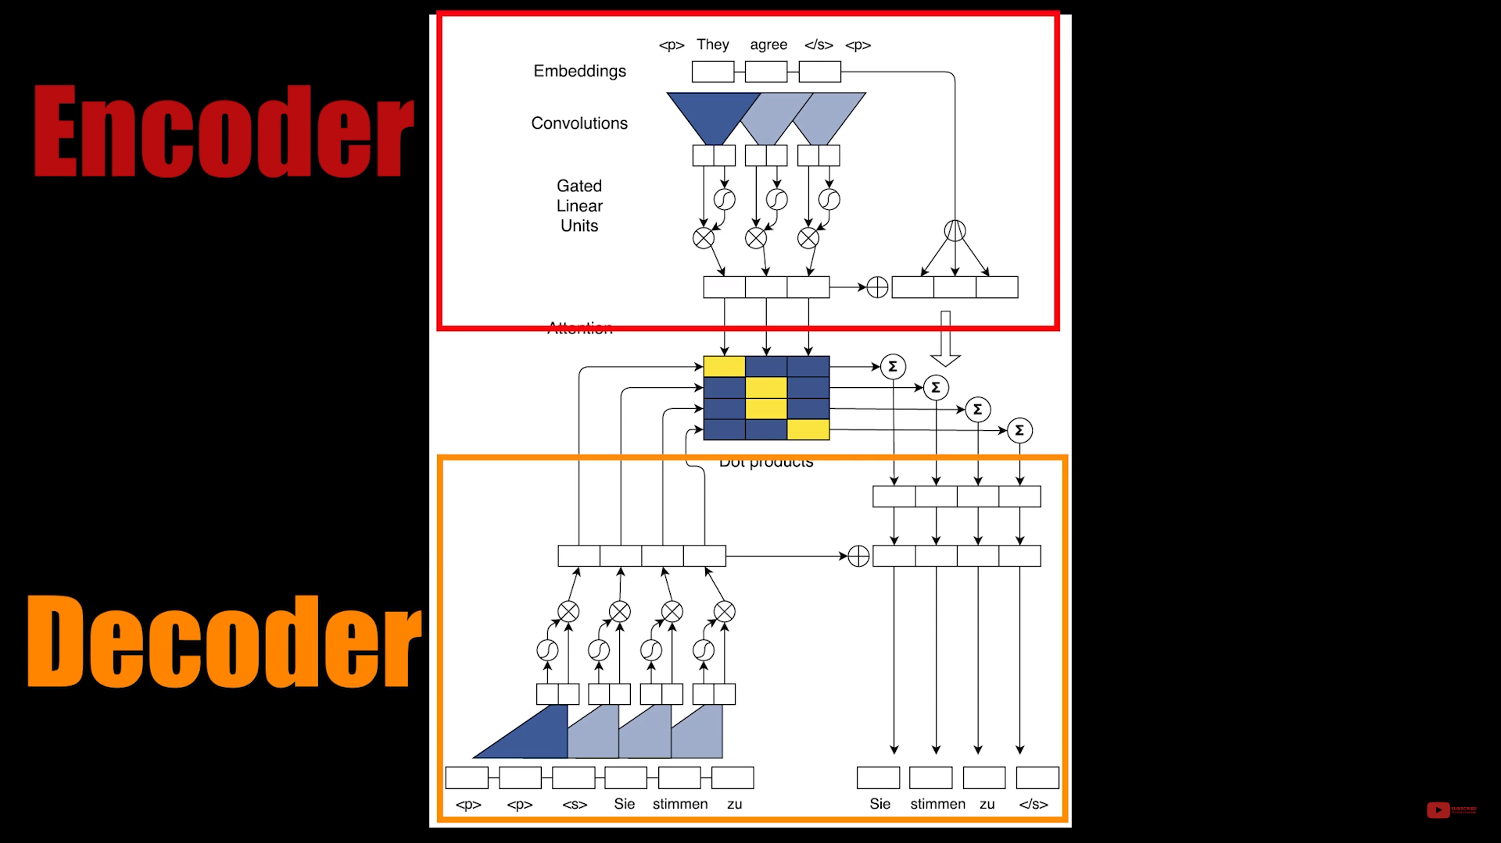
Models
Fairseq is a sequence modeling toolkit for training custom models for translation, summarization, and other text generation tasks. It provides reference implementations of various sequence-to-sequence models, including Long Short-Term Memory (LSTM) networks and a novel convolutional neural network (CNN) that can generate translations many times faster than comparable recurrent neural network (RNN) models.

Slide 4

Result
Model | Epochs | Training Time | BLEU4 (beam1) | BLEU4 (beam5) | BLEU4 (beam10) | BLEU4 (beam20)
fairseq | 25 | ~4.5hrs | 63.49 | 62.22 | 62.52 | 62.74
fairseq_enc7 | 33 | ~5hrs | 66.4 | 65.52 | 65.8 | 65.96
fairseq_dec5 | 28 | ~5hrs | 65.65 | 64.71 | 64.91 | 64.98
blstm | 30 | ~8hrs | 64.59 | 64.15 | 64.38 | 63.76
convenc | 47 | ~7hrs | 50.91 | 56.71 | 56.83 | 53.66
According to the experiments, we find the training time for fairseq is much shorter, compared to blstm (Bi-LSTM), while yielding comparable results. While fairseq measures slightly worse BLEU scores vs blstm, some manual tests seem to favor fairseq. A hybrid model using convenc (Convolutional encoder, LSTM decoder) trains for much more epochs but performs much worse BLEU score. Besides, the combination of fairseq and some Unity Networking will generate better result.

Slide 5
Discussion
There is no right or wrong for RNNs and CNNs. We need to make good use of them.
In machine learning application, the training times matters!
We should always try some thing new to pursue higher accuracy and faster speed. It is a good idea to learn from available techniques and make them better.

